Slide 1
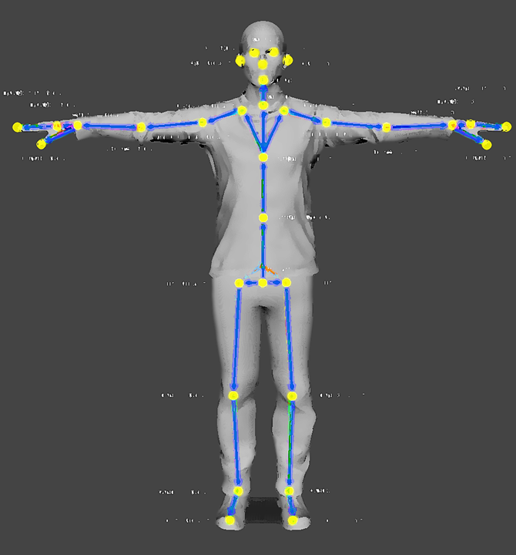
A
C
D
B
E
F
G
H
I
J
K
L

